Slide 1

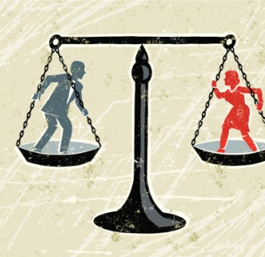
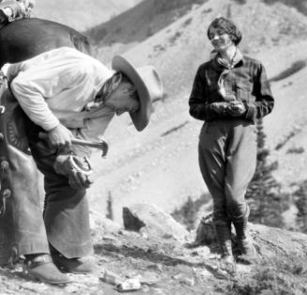
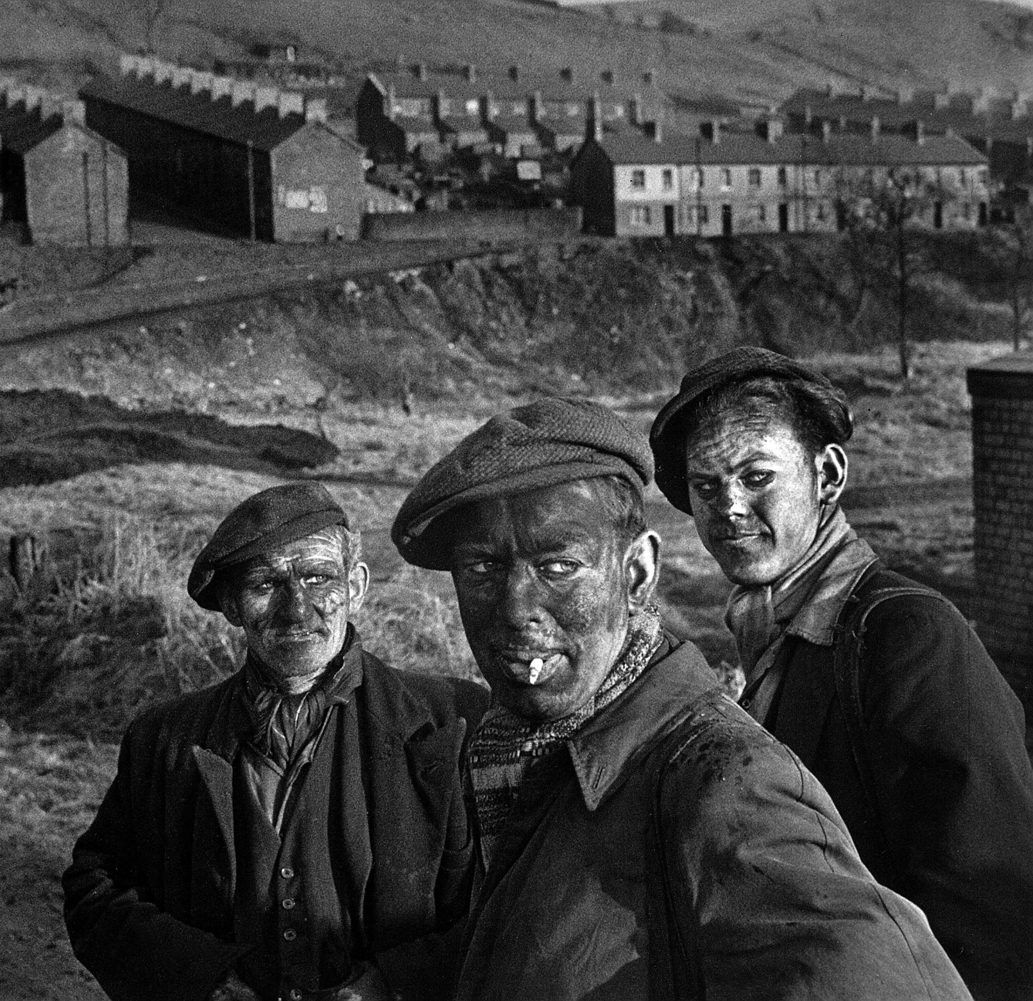
4
Unit 6 Section A
The weight men carry
FOREIGN LANGUAGE TEACHING AND RESEARCH PRESS
AIR FORCE ENGINEERING UNIVERSITY
Notes:
1

Slide 2

Practical Phrases | Specific Meanings
1. weld | ①锻接，焊接（金属）； ②使联合；使成为整体
2. lubricate | ①使润滑；给…加润滑剂/油 ②使顺利进行；促进
3. extract sth. from sth. | 从…中取出；从…中提炼
4. cater to sb./sth. | 迎合；满足；投合
5. emancipate sb. from | 使…摆脱；使…不受束缚
6. (have) a say on/over sth. | （有）发言权；（有）发言机会
7. be destined to do sth./for sth. | 注定；必然

Slide 3

Functional Patterns | Functions & Usages
1. Sb. do sth. for sth. else. This is what sb. is for — sb. is sth. like … | 用于形容“某人做某事是为了…”。
2. Sb. could no more do sth. than do sth. else … | 用于表达“某人两件事情都无法做”。
3. No doubt, had sb. taken a more adj. look/view at sth. sb. would have done sth. else. | 用于表达“某人对某事的反思”。
Notes:
3

Slide 4

①锻接，焊接（金属）；
②使联合；使成为整体
weld
短语逆译
短语应用
任何企业，如果想要成功，都必须将个人的努力融合到真正的团队中。
意群提示
(weld/ individual effort)
Any business, if it wants to succeed, must weld individual efforts into a true team.

Slide 5
①使润滑；给…加润滑剂/油
②使顺利进行；促进
lubricate
短语逆译
短语应用
在某种意义上，咖啡能够使社交顺利进行，甚至促进同事之间的关系。
意群提示
(lubricate/ social interactions )
In a certain sense, coffee can lubricate social interactions and even the relationship between co-workers.

Slide 6
从…中取出
从…中提炼
短语逆译
extract sth. from sth.
短语应用
一个好的侦探可以从少量的线索当中得到大量的信息。
意群提示
(extract… from/ cues)
A good detective can extract a lot of information from very few cues.

Slide 7
迎合；满足；投合
短语逆译
cater to sb./sth.
短语应用
好网站必须极具功能性以满足每一个访问者的期望和需求。
意群提示
(functional/ cater to)
A good website must be functional so as to cater to every visitor's wants and needs.

Slide 8
使…摆脱
使…不受束缚
emancipate sb. from
短语逆译
短语应用
18岁时，我上了大学，从父母的束缚中解放了出来。
意群提示
(emancipate sb. from)
When I was 18, I went to college and got emancipated from my parents.

Slide 9
（有）发言权
（有）发言机会
(have) a say on/over sth.
短语逆译
短语应用
他们唯一想要的就是对自己的财产有发言权。
意群提示
(have a say over/ property)
The only thing they want is to have a say over
their own property.

Slide 10

be destined to do sth./for sth.
注定；必然
短语逆译
短语应用
在追求真理的过程中，我们注定要遭受失败的痛苦。
意群提示
(be destined to/ suffer from)
We are destined to suffer from many failures in our quest for truth.

Slide 11
Functional Patterns | Functions & Usages
1. Sb. do sth. for sth. else. This is what sb. is for — sb. is sth. like … | 用于形容“某人做某事是为了…”。
2. Sb. could no more do sth. than do sth. else … | 用于表达“某人两件事情都无法做”。
3. No doubt, had sb. taken a more adj. look/view at sth. sb. would have done sth. else. | 用于表达“某人对某事的反思”。
Notes:
11

Slide 12
原句译文
但当战争一打响，他们很多人都会出于爱国热情而战死在疆场或异域前哨的堡垒前。这就是士兵的作用——他们就像工具，如同扳钳、锤子或螺丝一样。
逆译练习
But when the shooting started, many of them would die for their patriotism in fields and forts of foreign outposts. This was what soldiers were for – they were tools like a wrench, a hammer or a screw.
句型提炼
Notes:
12

Slide 13
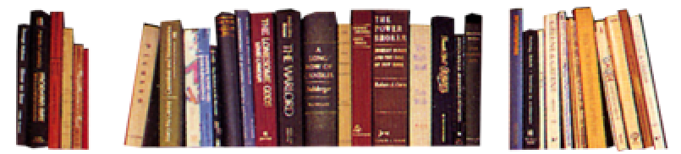
句型提炼
Sb. do sth. for sth. else. This is what sb. is for — sb. is sth. like …
应用提示
用于形容 “某人做某事是为了…”。
句型应用
Notes:
13

Slide 14
典型例句
当灾难发生，消防员战士都会出于爱国热情而冲在灾难现场第一线。这就是消防员战士的作用——他们就像英雄，如同超人、铁人一样。
意群提示
( disaster /firefighter/frontline)
When the disaster happened, many of firefighters would sacrifice for their patriotism in frontline of the disaster. This was what firefighters were for – they were heroes like superman, ironman.

Slide 15
原句译文
我不能想象自己长大会变成这些精明世故的人中的一员，就像我无法想象自己能变成一个权力至高无上的国君一样。
逆译练习
I could no more imagine growing up to become one of these sophisticated people than I could imagine becoming a sovereign prince.
句型提炼
Notes:
15

Slide 16
句型提炼
Sb. could no more do sth. than do sth. else …
应用提示
用于表达 “某人两件事情都无法做”。
句型应用
Notes:
16

Slide 17
典型例句
他无法忘却那段经历，就像他不会忘记自己的名字一样。
意群提示
(could no more… than …)
He could no more forget about the experience than he could forget his own name.

Slide 18
原句译文
毋庸置疑，如果我用更具理性的方式审视她们的生活，我就不会那么嫉妒她们了。
逆译练习
No doubt, had I taken a more deductive look at their lives, I would have envied them less.
句型提炼
Notes:
18

Slide 19
句型提炼
No doubt, had sb. taken a more … (adj.) look/view at sth., sb. would have done sth. else.
应用提示
用于表达 “某人对某事的反思”。
句型应用
Notes:
19

Slide 20
典型例句
毋庸置疑，如果人类用更具前瞻性的方式审视对大自然的开采，他们就不会遭受资源短缺了。
意群提示
(prospective/ exploitation/ resources shortage)
No doubt, had human beings taken a more prospective view at the exploitation of the nature, they would have never suffered from resources shortage.

Slide 21



当我还是个小男孩时，我住在弗吉尼亚州一个偏远的地区，那时我所认识的男人们从清晨的第一声公鸡啼
鸣一直劳作到日落。
a. When I was a boy growing up off the grid in the Commonwealth of Virginia, the men I knew labored with their bodies from the first rooster crow in the morning to sundown. (Para. 1, L1)

Slide 22
一份奖学金使我得以上大学，这可是我社交圈子里极其难得的荣耀。不仅如此，它还让我能够穿行于为富人家的孩子打造的史上著名的大学殿堂里。
b. A scholarship enabled me not only to attend college, a rare enough feat in my social circle, but even to traverse the halls of a historic university meant for the children of the rich. (Para. 5, L1)

Slide 23
我仿佛是透过望远镜
看到她们的生活，满是闪烁的星星和一缕缕光线，而漏掉了她们生活岁月的真实细节。
c. I saw their lives as through a telescope, all twinkling stars and shafts of light, missing the details that truly defined their days. (Para. 6, L7)

Slide 24
我认为别的男孩（女孩也一样）也会有我这样的迷惑，只要他们成长于一贫如洗的农村，成长于码头边或工厂附近——成长于任何让男人和女人的命运同样苍白和严酷的地方。
d. I think my bafflement has been felt by other boys (and by girls as well) who grew up in dirt-poor farm country, by the docks, in the shadows of factories– any place where the fates of men and women are symmetrically bleak and grim. (Para. 7, L3)

